Slide 1
Data Structure Design (2018-02)
Understanding Problems

Slide 2
1. Team Introduction
2. Understanding Problems
Contents
3. Data Sets
4. Q&A

Slide 3
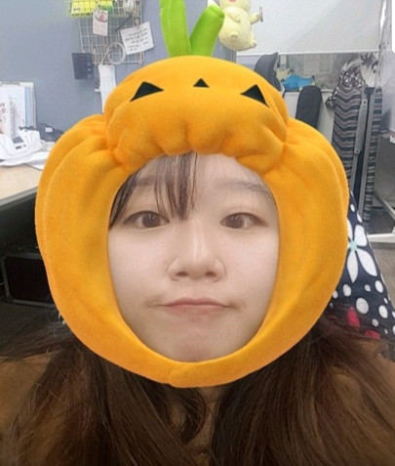




Team Introduction
Member
또또와 자료구조 설계
또구설계
Team
Introduction
Leader
Team Introduction
Understanding Problems
About Data
Q & A
권도경 (20154077)
김성재 (20133659)
박미지 (20150207)
이 용 (20120596)
조원희(20153129)
안드로이드 구현
Program 구조 설계
안드로이드 구현
안드로이드 코드 총괄
안드로이드 구현
UI 및 시나리오 작성
알고리즘 설계
알고리즘 구현
알고리즘 설계
알고리즘 구현
* Data Collecting -> All Member
* Write Document -> All Member (Using Google Docs)

Slide 4


Team Introduction
Communication
또또와 자료구조 설계
또구설계
Team
Introduction
Team Introduction
Understanding Problems
About Data
Q & A
https://github.com/orgs/DDoGuSulGye
깃 허브
카카오톡

Slide 5




Understanding Problems
Definition
Understanding
Problems
Dynamic Map on @100
Team Introduction
Shortest
Understanding Problems
About Data
The goal of this project is to suggest people to
best paths from room A to room B within Building 310
Q & A
Comfortable
Diet & Health

Slide 6



About DATA
Needs
About
DATA
Team Introduction
Understanding Problems
About Data
Q & A
Map
Wi-fi
Lecture Information
310관의 단면도
엘리베이터 주변 AP 정보
310관 강의 정보

Slide 7
Q&A
Q&A
Team Introduction
Understanding Problems
About Data
Q & A
Thank you.

